Slide 1

Department of Computer Science and Artificial Intelligence, SR University, Warangal
Course Code | Course Title | L | R | P | Cradit
20EC163 | AI Assisted Coding | 0 | 0 | 4 | 2
Course Type: Program Core
Dr. Brij Kishor Tiwari
(Assistant Professor)

Slide 2
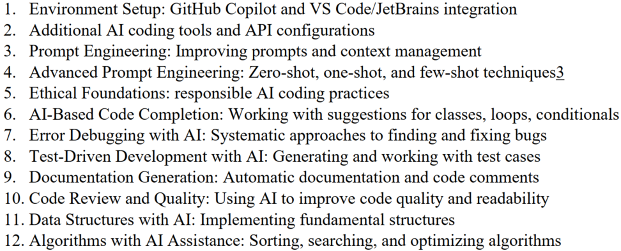
Syllabus [List of the Experiment]
Slide Title

Slide 3
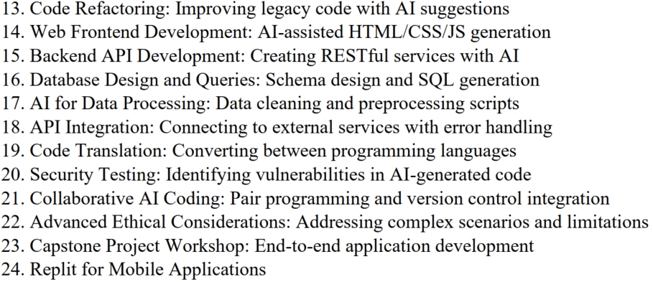
Syllabus [List of the Experiment]

Slide 4
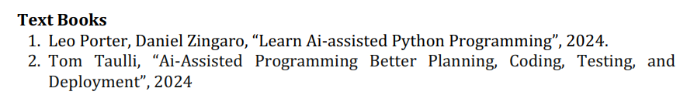
Reference Books
Slide Title

Slide 5
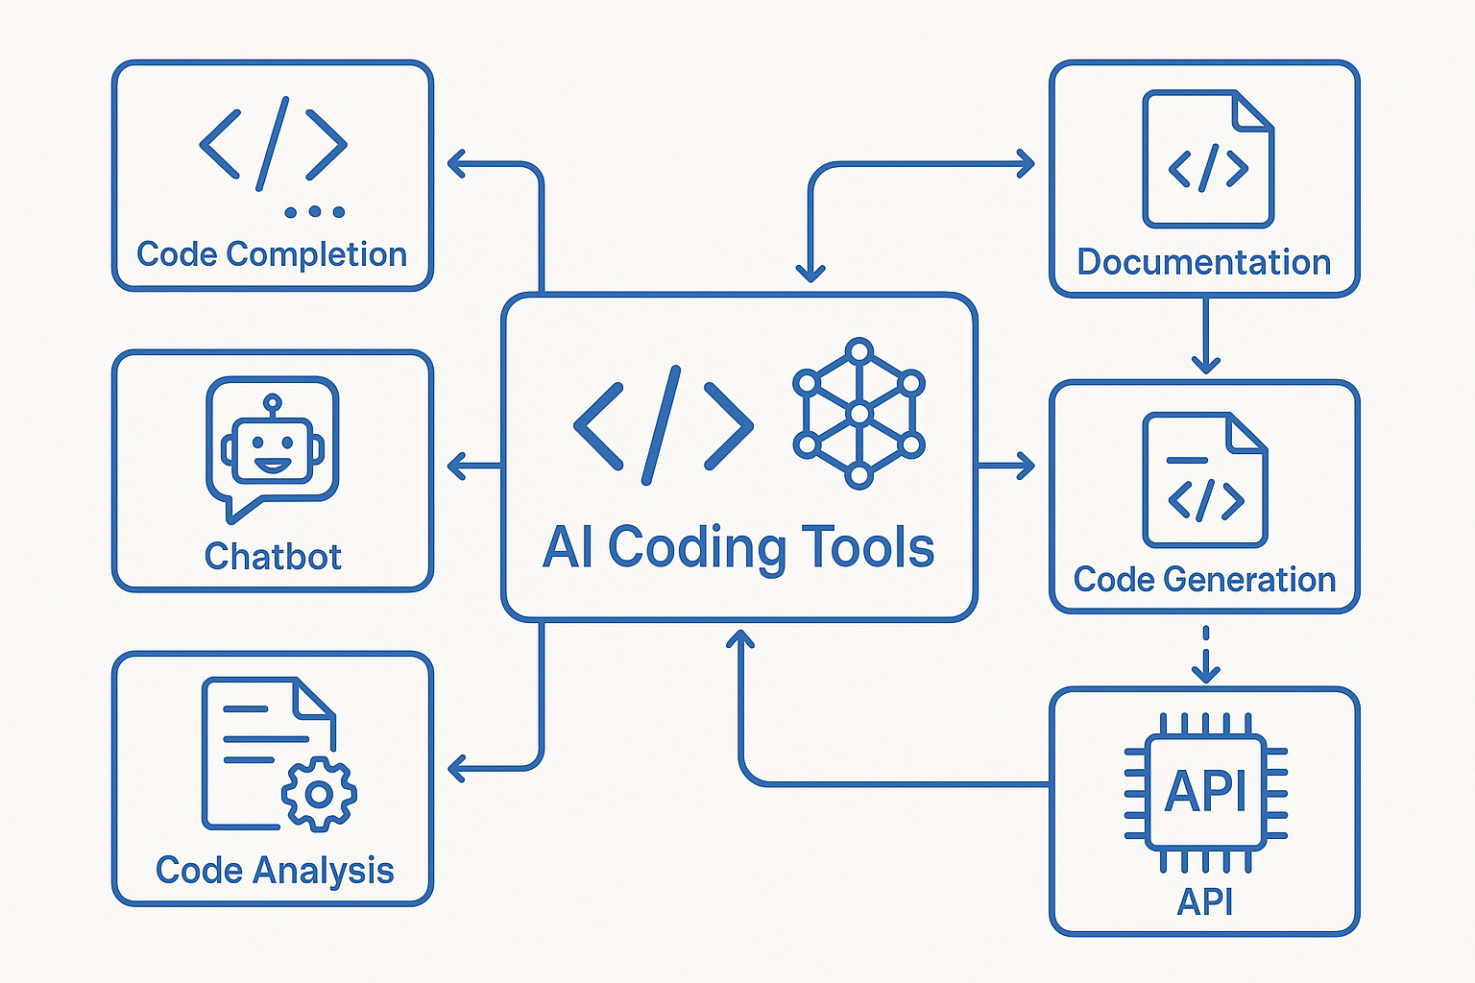
AI-Assisted Coding

Slide 6
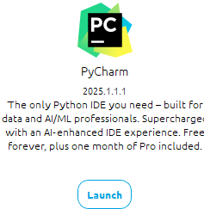
Exp.1: GitHub Copilot and VS Code/JetBrains integration
Slide Title
It is a company that develops a range of IDEs
Integrated Development Environment [IDEs]

Slide 7

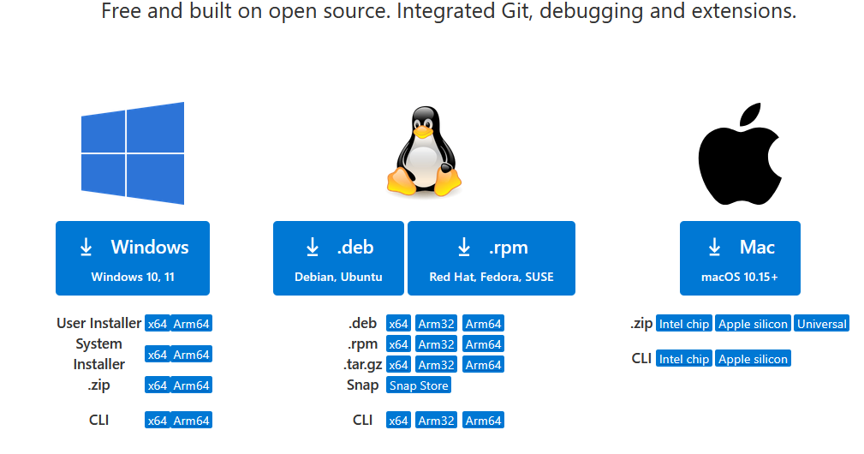
Installation Method for VS Code
https://code.visualstudio.com/download

Slide 8
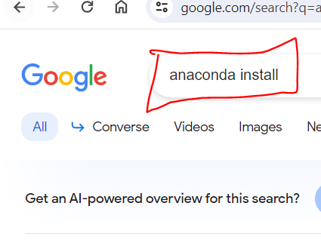
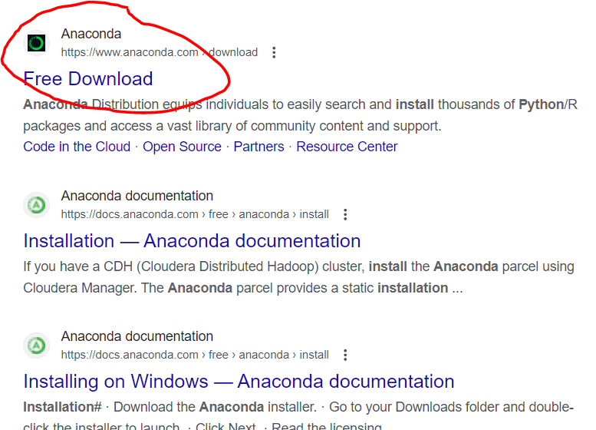
Methods to Install Number of IDEs using anaconda

Slide 9
Conda, Anaconda and Miniconda
Conda is the package and environment manager that's included in all versions of Anaconda.
Example: conda install numpy, conda install pandas
Anaconda is a set of about a hundred packages including conda, numpy, scipy, ipython notebook, and so on.
Miniconda, which is a smaller alternative to Anaconda that is just conda and its dependencies.
Anaconda Navigator is a specific GUI tool within the Anaconda distribution that facilitates the management and launch of these tools in a user-friendly manner.

Slide 10
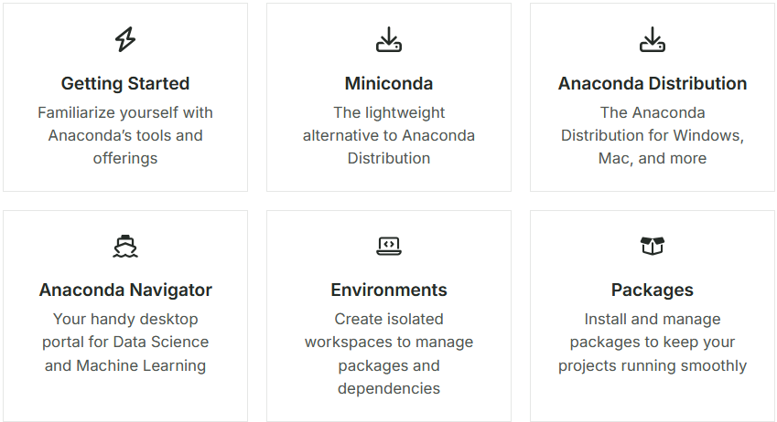
Anaconda Documentation
https://www.anaconda.com/docs/main

Slide 11
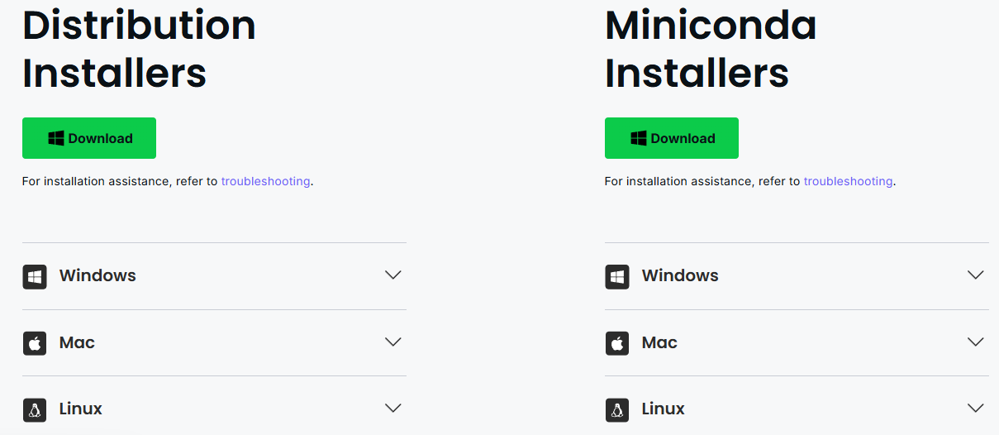
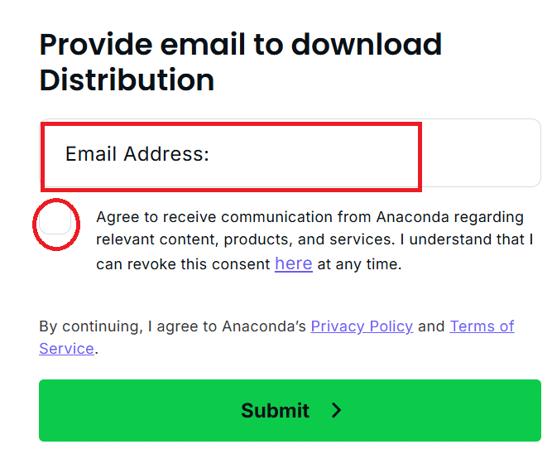

Link To Download file
Methods to install anaconda
https://www.anaconda.com/download

Slide 12
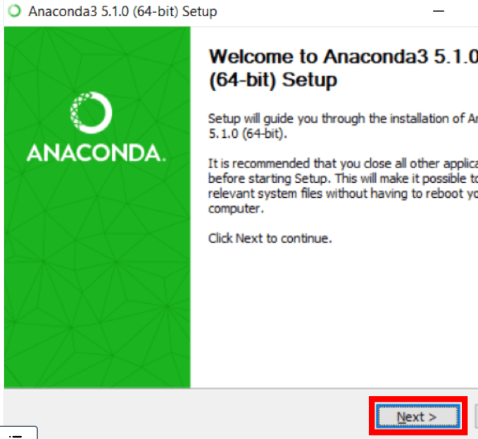
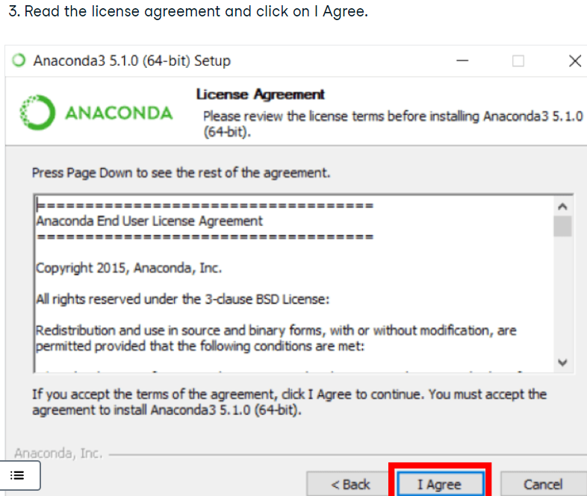
Methods to install anaconda

Slide 13
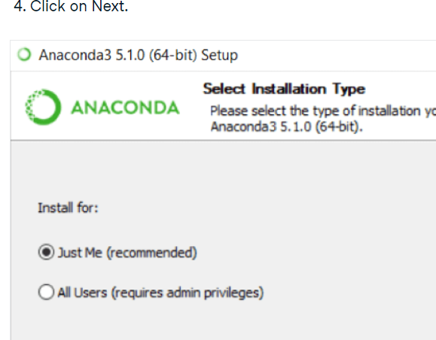
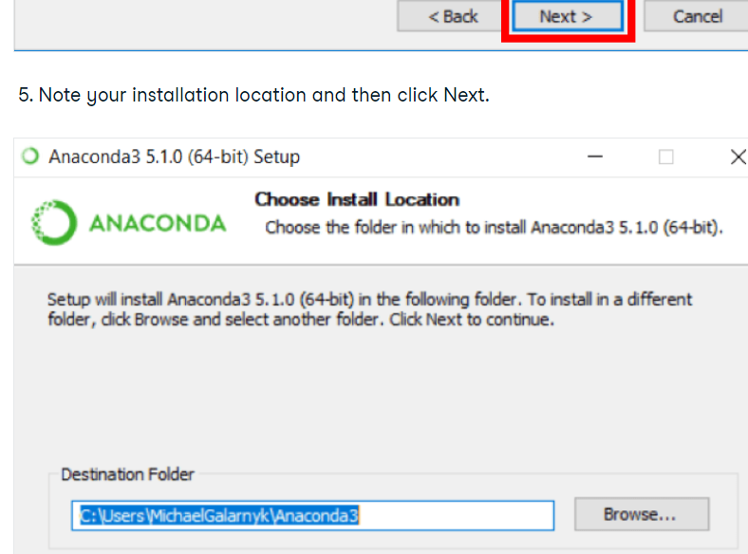
Methods to install anaconda

Slide 14
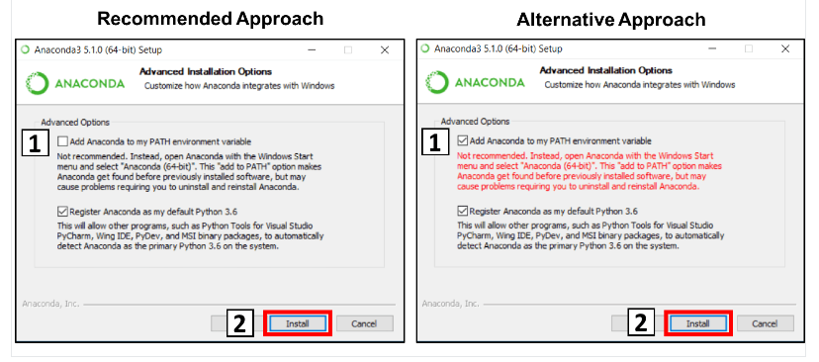
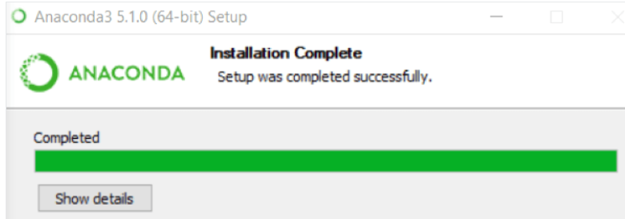
Methods to install anaconda

Slide 15
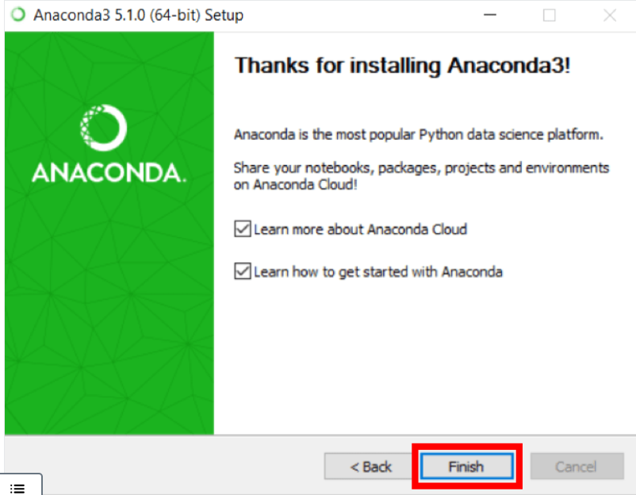
Methods to install anaconda

Slide 16
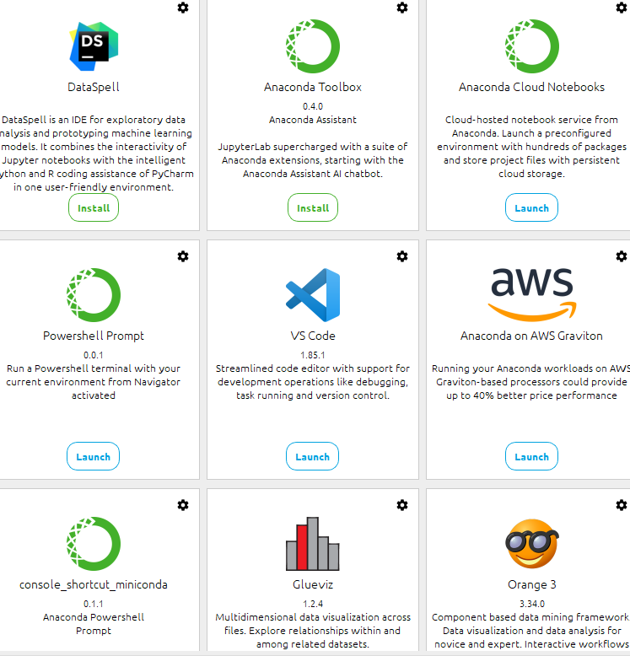
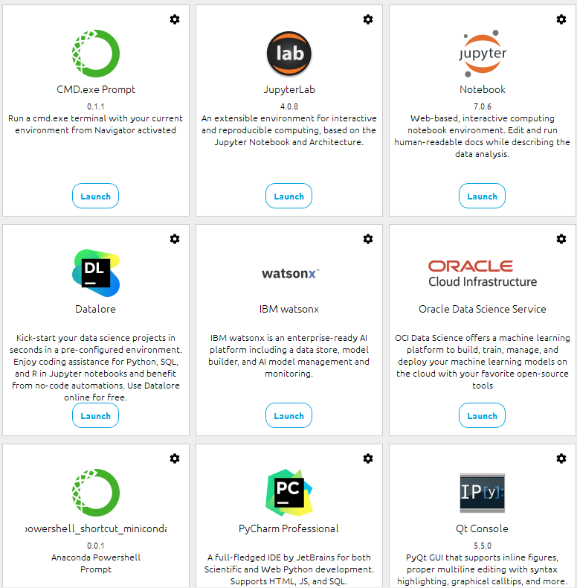
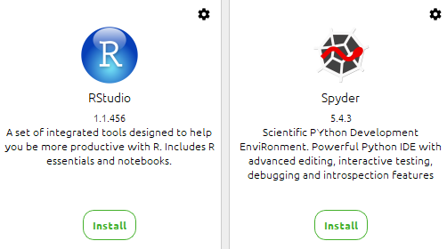
Anaconda-Navigator

Slide 17
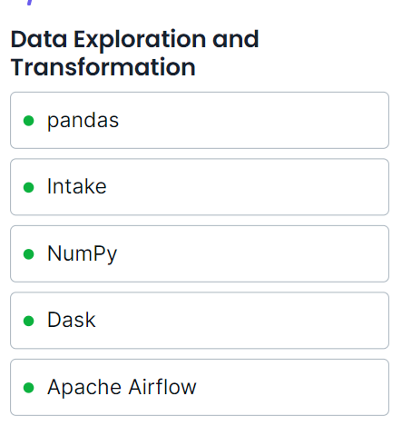
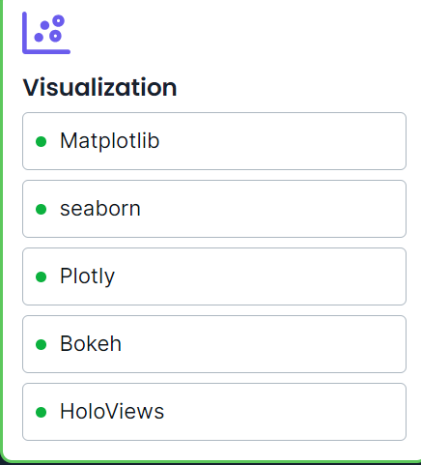
Anaconda's Powered Most Recommended and Trusted Open-Source Packages

Slide 18
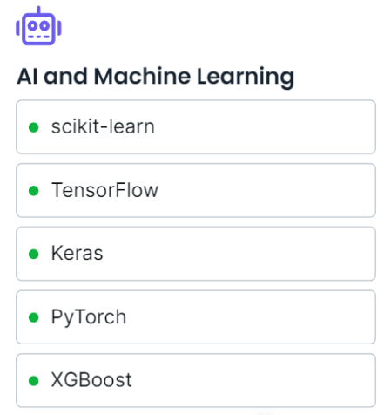
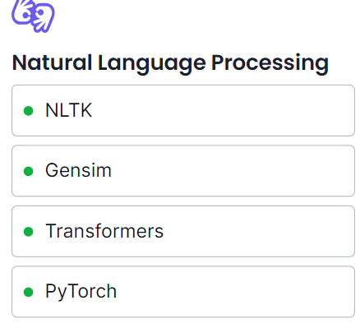
Anaconda's Powered Most Recommended and Trusted Open-Source Packages

Slide 19
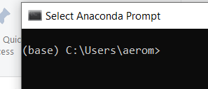
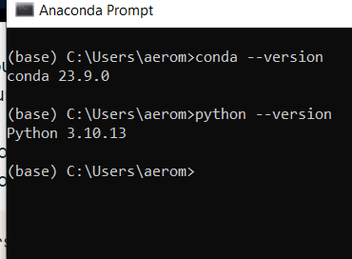
Check after installation
conda --version
python --version

Slide 20
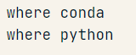
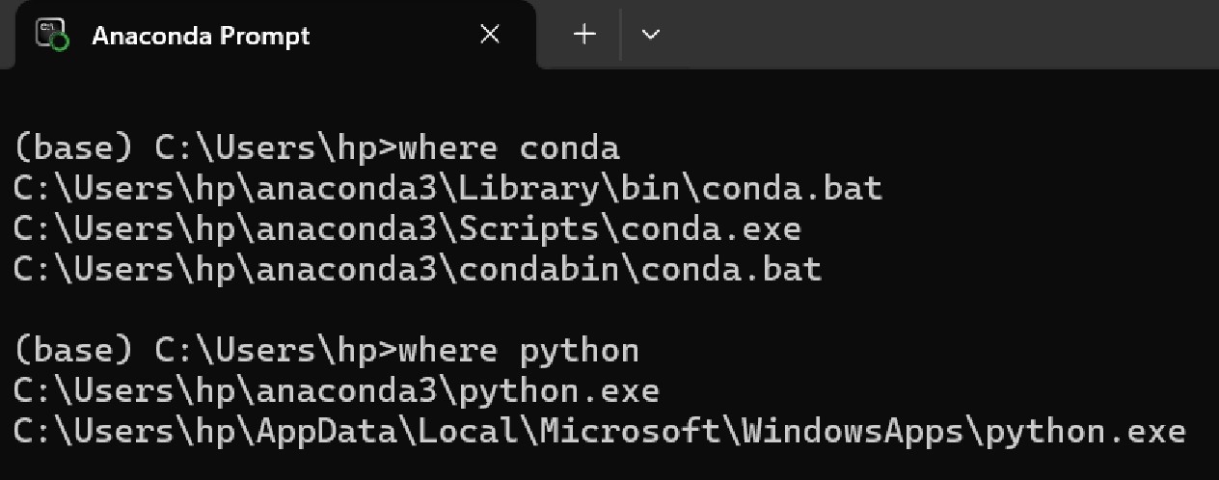
Check after installation
If you don't know where your conda and/or python is, open an Anaconda Prompt and type in the following commands. This is telling you where conda and python are located on your computer.

Slide 21
After Installation Check Anaconda-Navigator and Launch VS Code

Slide 22
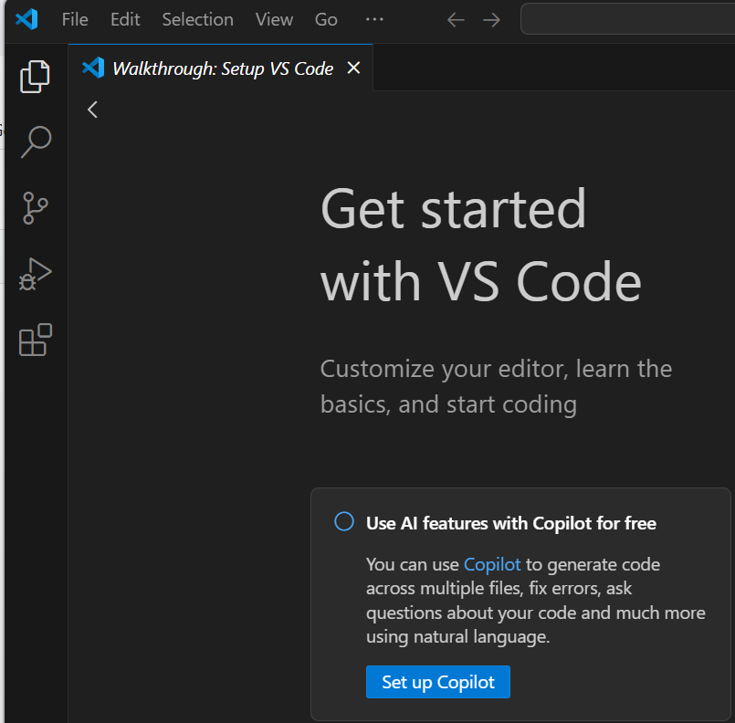
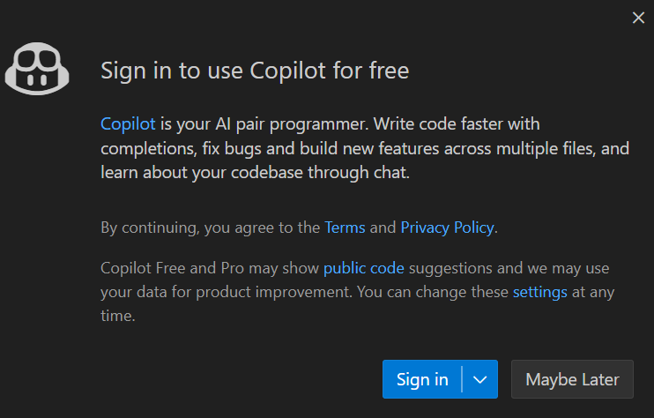
GitHub Copilot and VS Code Integration
GitHub Copilot Develop by Github and OpenAI

Slide 23
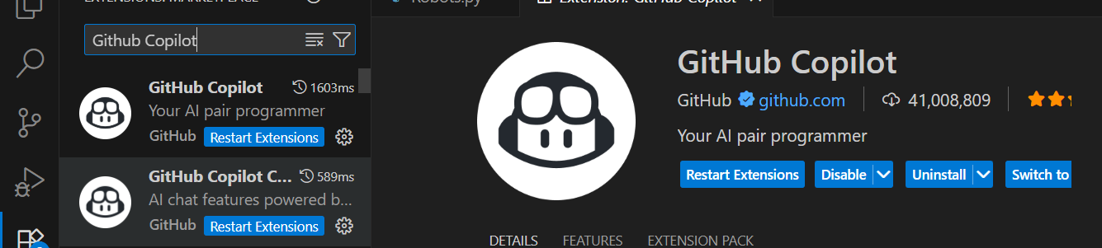
Login into the Github and Install the Github- Copilot extension in VS Code
GitHub Copilot and VS Code Integration
Go to https://github.com/signup and sign up for a GitHub Account GitHub’s documentation at https://docs.github.com/en/copilot/getting -started-with-github-copilot

Slide 24
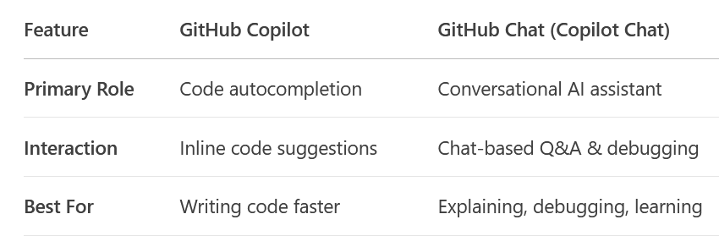
Install Github- Copilot vesus Github Chat Extension in VS Code

Slide 25
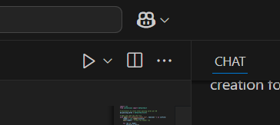
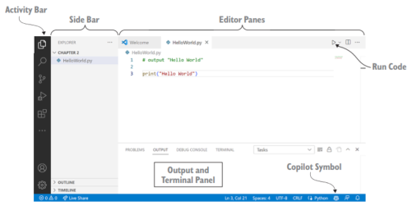
Working with Copilot in Visual Studio Code

Slide 26
Code completions with GitHub Copilot in VS Code
http://code.visualstudio.com/docs/copilot/ai-powered-suggestions

Slide 27
Common slash commands and their usage
/explain - Provides an explanation of the selected code.
/suggest - Offers code suggestions based on the current context.
/tests - Generates unit tests for the selected function or class.
/comment - Converts comments into code snippets.

Slide 28
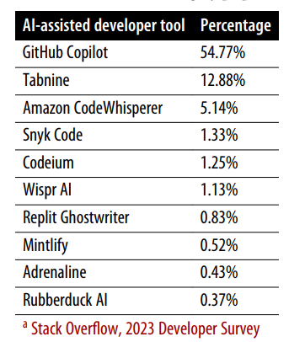
Why and which AI-assisted tools to use !!
Ranking based on the popularity

Slide 29
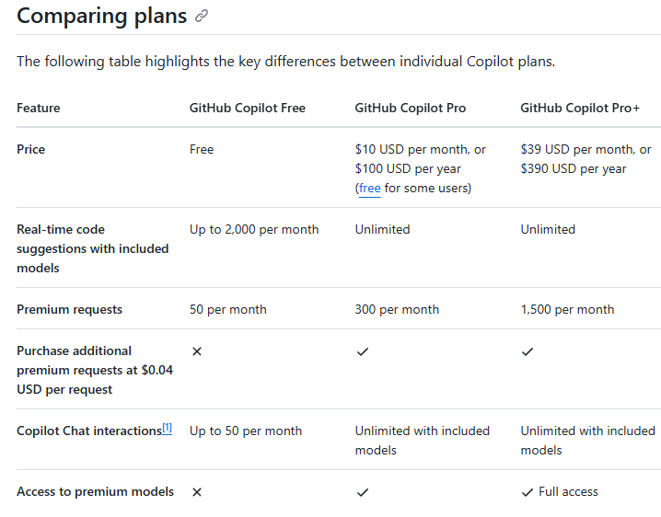
GitHub Copilot Plans
Why and which AI-assisted tools to use !!

Slide 30
Developed of PythonVirtual Environnements in VS Code
Slide Title
Local environments
Global environments
By default, any Python interpreter installed runs in its own global environment.
For example, if you just run python, python3, or py at a new terminal (depending on how you installed Python), you're running in that interpreter's global environment.
Virtual Environment
It is a built-in way to create an environment
A virtual environment creates a folder that contains a copy to a specific interpreter.
When you install packages, it will end up in this new folder isolated from other packages used by other workspaces.
2. Conda Environment
python environment managed using the conda package manage

Slide 31
Developed of PythonVirtual Environnements in VS Code
Slide Title
Open the VS Code terminal,
Type the following:
Creating virtual environment in same directory or in different directory with
Name of the virtual environment folder as
[.venv or venv or New_Virtual_Env]
python -m venv .venv
python -m venv venv
Activate New Virtual Environment

Slide 32
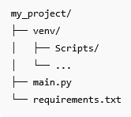
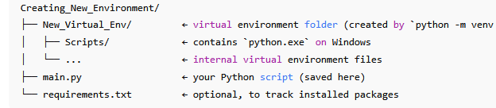
Where to save the python script ??

Slide 33
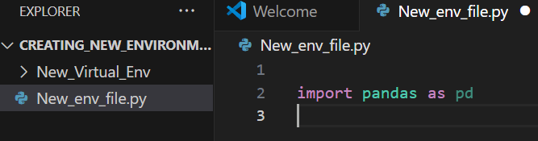
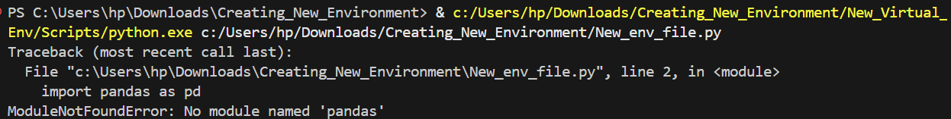
How to install libraries in the Virtual environment

Slide 34
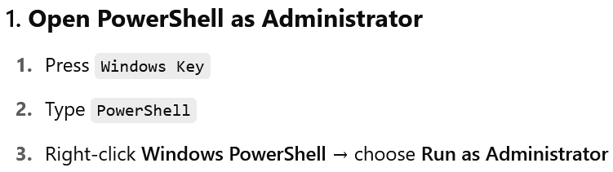
Activation/Deactivation Error !!

Slide 35
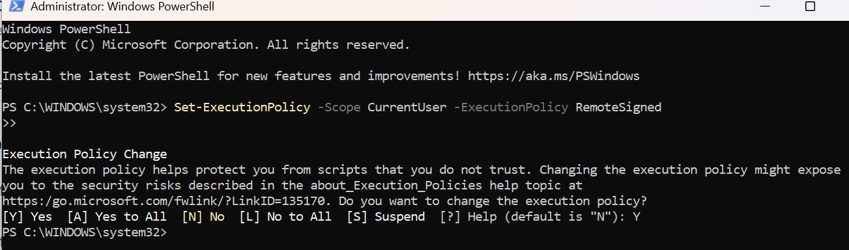
Example Solution !!

Slide 36

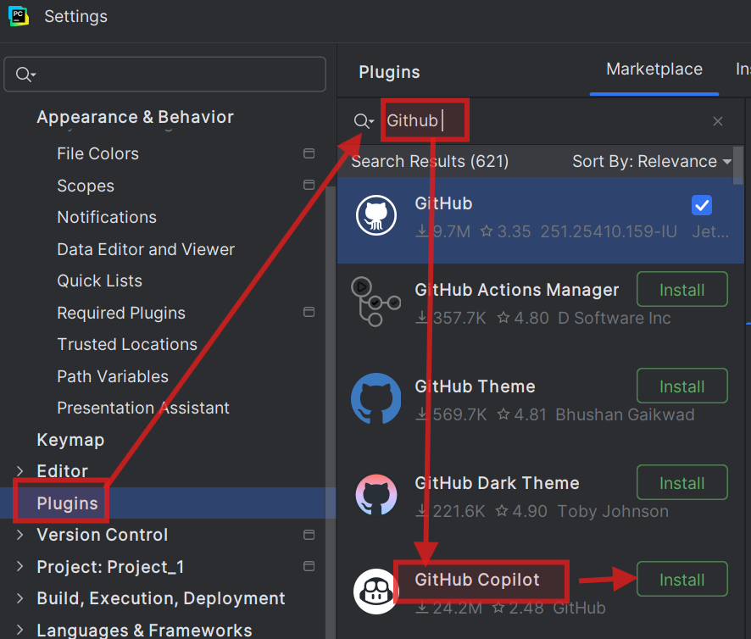
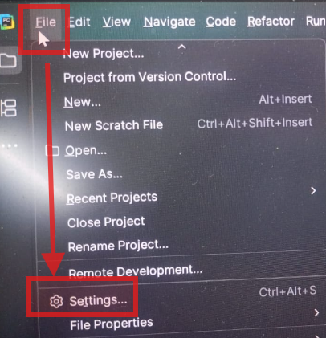
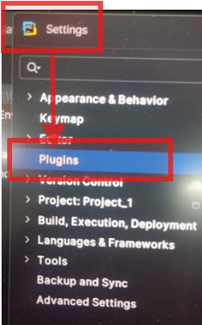
GitHub Copilot and JetBrains Integration

Slide 37
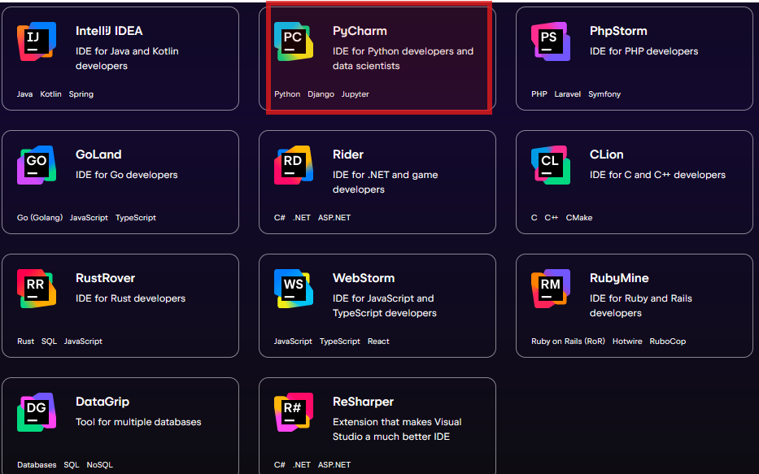

List of Other JetBrains IDEs

Slide 38
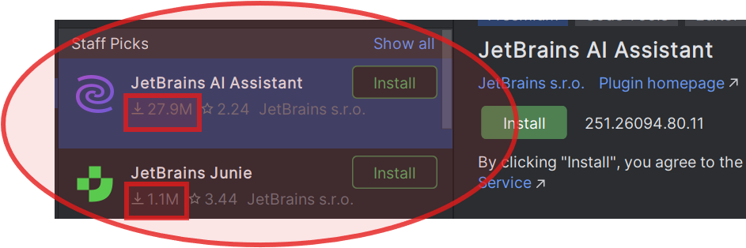
JetBrains AI Assistant Option

Slide 39
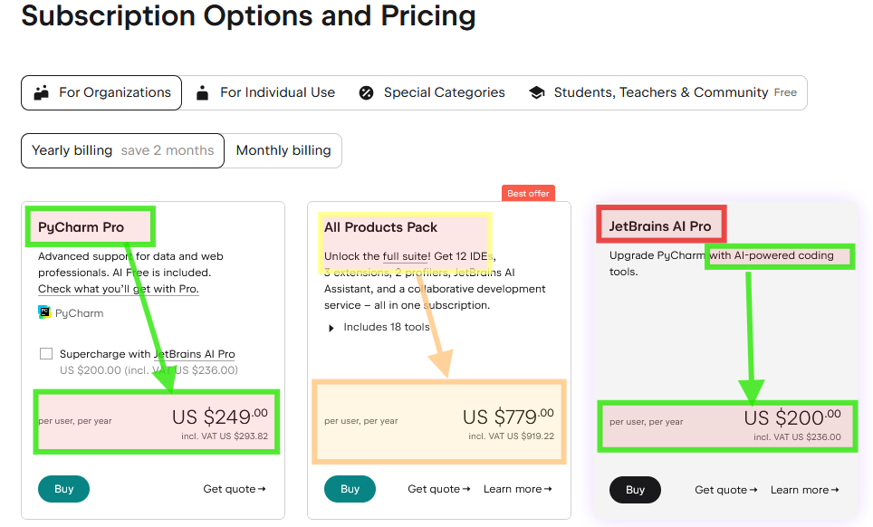
Subscription option

Slide 40
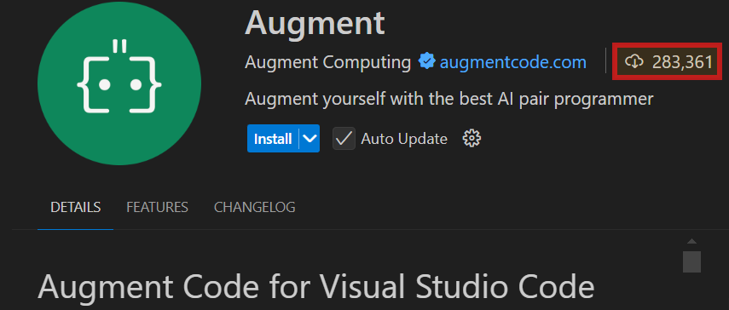
Lab 2: Additional AI coding tools and API configurations

Slide 41

Lab 2: Additional AI assisted coding tools “JetBrains AI assistant”
Extension for VS Code
Extension for PyCharm

Slide 42

Lab 2: Additional AI assisted coding tools “Augment”

Slide 43


Lab 2: Additional AI assisted coding tools “Tabnine”

Slide 44

Lab 2: Additional AI assisted coding tools “Amazon CodeWhisperer ”
Amazon CodeWhisperer has now been rebranded and bundled as the Amazon Q and you should install Amazon Q instead of a standalone CodeWhisperer extension.
For IDE VS Code install Amazon Q from the VS Code extension
For IDEs like IntelliJ, PyCharm, etc. use the Amazon Q plugin

Slide 45


Lab 2: Additional AI assisted coding tools “CursorCode” and Qodo Gen: AI Coding Agent ”

Slide 46
Lab 2: Additional AI coding tools
AI coding tools typically include
Libraries,
Frameworks, or
APIs that enable developers to integrate AI capabilities into applications.
AI coding tools Examples
TensorFlow,
PyTorch,
Hugging Face
Transformers, etc.

Slide 47


Lab 2: Openweathermap API
https://openweathermap.org/api

Slide 48

Lab 2: Openweathermap API

Slide 49


Lab 2: News API
https://newsapi.org/

Slide 51
Lab 3:
Prompt Engineering: Improving prompts and context management

Slide 52
Prompt Engineering: Improving prompts and context management
Copilot can write our code, explain it, and fix bugs in it,
So, we are we just done ??
Ans: BIG NOOO
Prompt Engineering

Slide 53
What is Prompt?
Prompt Engineering: Improving prompts and context management
How to tell Copilot what to do.

Slide 54
Prompt Engineering: Improving prompts and context management
Prompt Engineering is the practice of designing and refining input prompts to guide the behavior of AI models.
It helps to control AI output
Improves relevance and accuracy
Essential for applications using LLMs

Slide 55
Prompt Engineering: Why Prompt Engineering Matters
Effective prompts lead to better AI responses.
Used in chatbots, coding assistants, content generation
Improves user experience
Reduces ambiguity and errors

Slide 56

Prompt Engineering: Improving prompts and context management
Major Components of the Prompt
Constraints

Slide 57

Instruction: Prompts for Summarization
Lab 3: Prompt Engineering: Improving prompts and context management

Slide 58

Lab 3: Prompt Engineering: Instruction
Text Classification
(Sentiment Analysis)
Recommendation
Translation
Translation

Slide 59

Example 1: Summarizing a Document
Prompt Engineering: Improving prompts and context management
Instruction: Summarize the document.
Context: The document is a research paper.
Input Data: Full text of the paper.
Output Format: Bullet points.
Constraints: Limit to 100 words.

Slide 60

Example 2: Generating a Recipe
Prompt Engineering: Improving prompts and context management
Instruction: Create a recipe.
Context: User has tomatoes, onions, and pasta.
Input Data: List of ingredients.
Output Format: Step-by-step instructions.
Constraints: Vegetarian only.

Slide 61

Example 3: Writing a Cover Letter
Prompt Engineering: Improving prompts and context management
Instruction: Write a cover letter.
Context: Applying for a software engineer role.
Input Data: Resume details.
Output Format: Formal letter.
Constraints: One page only.

Slide 62

Example 4: Creating a Chart
Prompt Engineering: Improving prompts and context management
Instruction: Generate a bar chart.
Context: Sales data for Q1.
Input Data: Monthly sales figures.
Output Format: Bar chart image.
Constraints: Use blue color for bars.

Slide 63

Example 5: Translating Text
Prompt Engineering: Improving prompts and context management
Instruction: Translate to French.
Context: Text is a travel guide.
Input Data: English paragraphs.
Output Format: French text.
Constraints: Maintain original formatting.

Slide 64
Prompt Engineering: Improving prompts and context management
Best Practices: Tips for crafting effective prompts.
Be specific and clear
Use examples
Iterate and refine
Avoid ambiguity

Slide 65
Lab 4: Advanced Prompt Engineering: Zero-shot, one-shot, and few-shot techniques
Prompt Engineering Tools

Slide 66
Prompt Engineering: Types of Prompts
Different prompting techniques for different tasks.
Zero-shot: No examples provided
One-shot: One example provided
Few-shot: Few examples provided
Chain-of-thought: Step-by-step reasoning

Slide 67
Prompt Engineering Tools
Tools and frameworks to assist in prompt design.
Prompt libraries
Prompt tuning
Evaluation frameworks

